Slide 1
Lecture 14, still lesson 9: Damped and driven oscillations
Teacher: Dr. Paul Briard

Slide 2








Damped oscillations, summary
$$\vec{n}$$
$${\vec{F}}_{spring}$$
$$\vec{v}$$
$${\vec{F}}_{friction}$$
$$x$$
$$x=0$$
$$\vec{w}$$
Now we consider a friction force exerted on the block, such as:
$$F_{friction,x}=−bv_{x}$$
$b$: damping coefficient (a real and positive number)
$x$-velocity of the block (could be positive or negative)

Slide 3

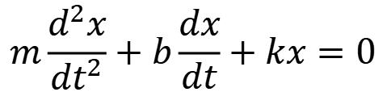


Damped oscillations, summary
Damped oscillations of a spring-mass system, the displacement from equilibrium is:
$$x(t)=Ae^{− \frac{b}{2m}t}\cos\left(ω^{′}t+φ\right)$$
Important to remember
Solution of the equation, if the condition of underdamping is satisfied :
$$b<2\sqrt{mk}$$
$$m\frac{d^{2}x}{{dt}^{2}}+b\frac{dx}{dt}+kx=0$$
Important to remember
mass
Damping coefficient
Spring coefficient (spring constant)
Angular frequency of the damped oscillations:
$$ω^{′}=\sqrt{\frac{k}{m}−\frac{b^{2}}{4m^{2}}}≠\sqrt{\frac{k}{m}}$$

Slide 4


Damped oscillations, summary
Underdamping
Critical damping
Overdamping
$$b<2\sqrt{mk}$$
$$b=2\sqrt{mk}$$
$$b>2\sqrt{mk}$$
The spring – mass system returns to equilibrium with oscillations
The spring – mass system returns to equilibrium without oscillations

Slide 5

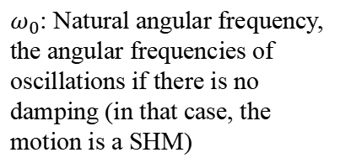
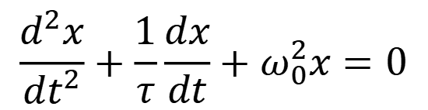
Damped oscillations, summary
Damped oscillations of a spring-mass system, the displacement from equilibrium is:
$$m\frac{d^{2}x}{{dt}^{2}}+b\frac{dx}{dt}+kx=0$$
Important to remember
Other form is (which can describe damped oscillations of other kinds of systems):
$$\frac{d^{2}x}{{dt}^{2}}+\frac{1}{τ}\frac{dx}{dt}+ω_{0}^{2}x=0$$
Important to remember
$ω_{0}$: Natural angular frequency, the angular frequencies of oscillations if there is no damping (in that case, the motion is a SHM)
$τ$:damping time constant

Slide 6

Damped oscillations, summary
Damped oscillations of a spring-mass system, the displacement from equilibrium is:
$$m\frac{d^{2}x}{{dt}^{2}}+b\frac{dx}{dt}+kx=0$$
Important to remember
Change rate of the mechanical energy of a spring-mass system:
$$\frac{{dE}_{m}}{dt}=P={\vec{F}}_{friction}.\vec{v}$$
Important to remember
In the case of damped oscillations, the change rate of mechanical energy is the power of the friction force.

Slide 7










About complex numbers
$$\tilde{z}=a+ib$$
imaginary
Any complex number can have this form:
$$b$$
$$+\tilde{z}$$
$a$ is the real part of $\tilde{z}$:
$$a=Re\{\tilde{z}\}$$
real
$$a$$
$b$ is the imaginary part of $\tilde{z}$:
$$b=Im\{\tilde{z}\}$$
The complex plane
$i$ is the imaginary unit:
$$i^{2}=−1$$
$$\tilde{z}=ρe^{iφ}$$
Any complex number can also have this form:
$ρ$ is the modulus of the complex number:
$$ρ=\left|\tilde{z}\right|=\sqrt{a^{2}+b^{2}}$$
$φ$ is the argument of the complex number:
$$φ=Arg \left(\tilde{z}\right)=\arctan\left(b/a\right)$$

Slide 8









Interest of complex numbers: the particular properties of the exponential function
Examples:
Product between two complex numbers:
$${\tilde{z}}_{1}=ρ_{1}e^{iφ_{1}}$$
$${\tilde{z}}_{1}{\tilde{z}}_{2}=ρ_{1}ρ_{2}e^{i{(φ}_{1}+φ_{2})}$$
$${\tilde{z}}_{2}=ρ_{2}e^{iφ_{2}}$$
Product between a complex number and its complex conjugate:
$$\tilde{z}=ρe^{iφ}$$
$$\tilde{z}{\tilde{z}}^{∗}=ρ^{2}$$
$${\tilde{z}}^{∗}=ρe^{−iφ}$$
$$\tilde{z}(t)=ρe^{irt}$$
Time derivative of $\tilde{z}(t)=ρe^{iφ(t)}$
For instance,
$$\frac{d}{dt}\left(ρe^{irt} \right)=irρe^{irt}$$
$$\frac{d^{2}}{dt^{2}}\left(ρe^{irt} \right)=−r^{2}ρe^{irt}$$

Slide 9
Driven oscillations

Slide 10
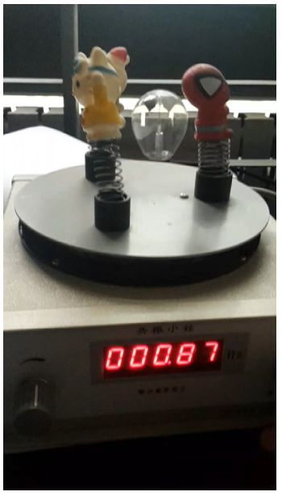
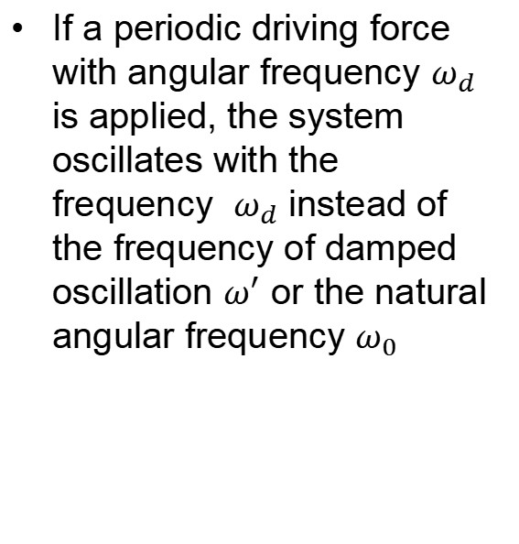
Driven oscillations
If a periodic driving force with angular frequency $ω_{d}$ is applied, the system oscillates with the frequency $ω_{d}$ instead of the frequency of damped oscillation $ω^{′}$ or the natural angular frequency $ω_{0}$

Slide 11
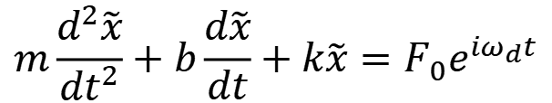
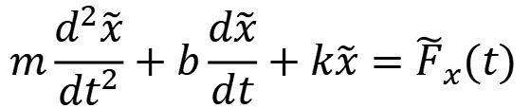
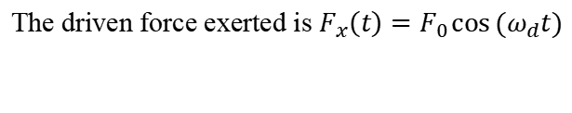
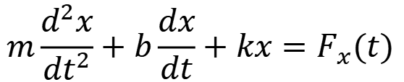
Driven oscillations
$$m\frac{d^{2}x}{{dt}^{2}}+b\frac{dx}{dt}+kx=F_{x}(t)$$
The driven force exerted is $F_{x}\left(t\right)=F_{0}\cos{(ω_{d}t)}$
The complex solution $\tilde{x}$which the real part is $x$ verifies:
$$m\frac{d^{2}\tilde{x}}{{dt}^{2}}+b\frac{d\tilde{x}}{dt}+k\tilde{x}={\tilde{F}}_{x}(t)$$
$$m\frac{d^{2}\tilde{x}}{{dt}^{2}}+b\frac{d\tilde{x}}{dt}+k\tilde{x}=F_{0}e^{iω_{d}t}$$
where ${\tilde{F}}_{x}\left(t\right)=F_{0}e^{iω_{d}t}$ is the complex number which the real part is $F_{x}\left(t\right)=F_{0}\cos{(ω_{d}t)}$

Slide 12
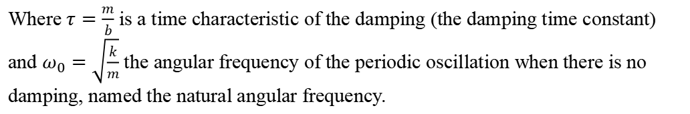
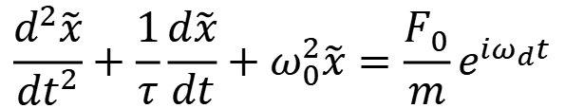
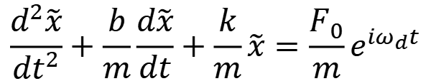
Driven oscillations
$$m\frac{d^{2}\tilde{x}}{{dt}^{2}}+b\frac{d\tilde{x}}{dt}+k\tilde{x}=F_{0}e^{iω_{d}t}$$
$$\frac{d^{2}\tilde{x}}{{dt}^{2}}+\frac{b}{m}\frac{d\tilde{x}}{dt}+\frac{k}{m}\tilde{x}=\frac{F_{0}}{m}e^{iω_{d}t}$$
$$\frac{d^{2}\tilde{x}}{{dt}^{2}}+\frac{1}{τ}\frac{d\tilde{x}}{dt}+ω_{0}^{2}\tilde{x}=\frac{F_{0}}{m}e^{iω_{d}t}$$
Where $τ=\frac{m}{b}$ is a time characteristic of the damping (the damping time constant) and $ω_{0}=\sqrt{\frac{k}{m}}$ the angular frequency of the periodic oscillation when there is no damping, named the natural angular frequency.

Slide 13
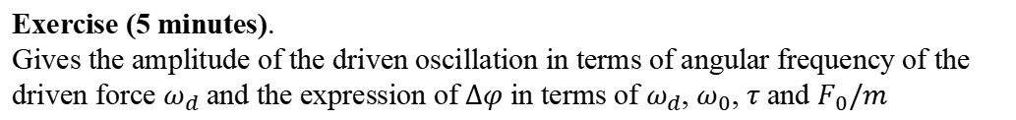
Amplitude of driven oscillations
$$\frac{d^{2}\tilde{x}}{{dt}^{2}}+\frac{1}{τ}\frac{d\tilde{x}}{dt}+ω_{0}^{2}\tilde{x}=\frac{F_{0}}{m}e^{iω_{d}t}$$
The solution $\tilde{x}(t)$has the form:
$$\tilde{x}(t) ={\tilde{x}}_{0}e^{iω_{d}t}=\left|{\tilde{x}}_{0}\right|e^{i∆φ}e^{iω_{d}t}$$
Which means the displacement is
$x=Re\left\{\hat{x}\right\}=A\cos\left(ω_{d}t+∆φ\right)$
Where $A=\left|{\tilde{x}}_{0}\right|$ is the amplitude of the driven oscillation and $∆φ=arg({\tilde{x}}_{0})$ is the phase difference between the oscillation and the excitation.
Exercise (5 minutes).
Gives the amplitude of the driven oscillation in terms of angular frequency of the driven force $ω_{d}$ and the expression of $∆φ$ in terms of $ω_{d}$, $ω_{0}$, $τ$ and $F_{0}/m$

Slide 14
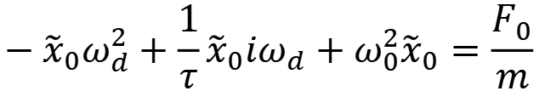
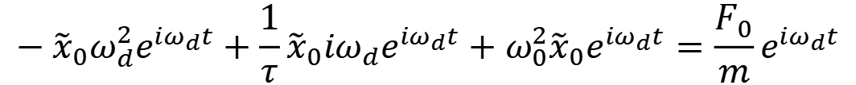
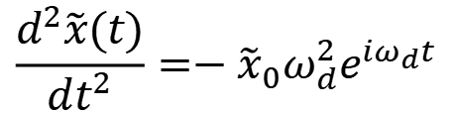
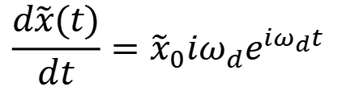

Amplitude of driven oscillations
$\tilde{x}(t)$has the form:
$$\tilde{x}(t) ={\tilde{x}}_{0}e^{iω_{d}t}=\left|{\tilde{x}}_{0}\right|e^{i∆φ}e^{iω_{d}t}$$
$$\frac{d\tilde{x}(t)}{dt}={\tilde{x}}_{0}iω_{d}e^{iω_{d}t}$$
$$\frac{d^{2}\tilde{x}(t)}{dt^{2}}=−{\tilde{x}}_{0}ω_{d}^{2}e^{iω_{d}t}$$
$$−{\tilde{x}}_{0}ω_{d}^{2}e^{iω_{d}t}+\frac{1}{τ}{\tilde{x}}_{0}iω_{d}e^{iω_{d}t}+ω_{0}^{2}{\tilde{x}}_{0}e^{iω_{d}t}=\frac{F_{0}}{m}e^{iω_{d}t}$$
$$−{\tilde{x}}_{0}ω_{d}^{2}+\frac{1}{τ}{\tilde{x}}_{0}iω_{d}+ω_{0}^{2}{\tilde{x}}_{0}=\frac{F_{0}}{m}$$

Slide 15
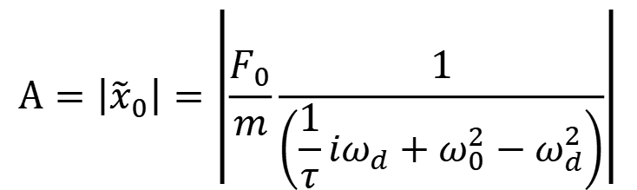
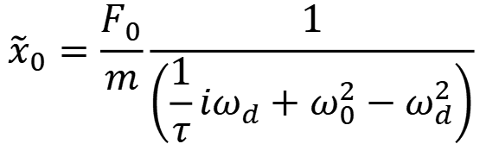
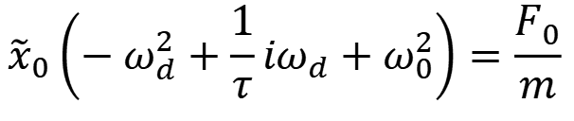
Amplitude of driven oscillations
$$−{\tilde{x}}_{0}ω_{d}^{2}+\frac{1}{τ}{\tilde{x}}_{0}iω_{d}+ω_{0}^{2}{\tilde{x}}_{0}=\frac{F_{0}}{m}$$
$${\tilde{x}}_{0}\left(−ω_{d}^{2}+\frac{1}{τ}iω_{d}+ω_{0}^{2}\right)=\frac{F_{0}}{m}$$
$${\tilde{x}}_{0}=\frac{F_{0}}{m}\frac{1}{\left(\frac{1}{τ}iω_{d}+ω_{0}^{2}−ω_{d}^{2}\right)}$$
The amplitude of the driven oscillations is:
$$A=\left|{\tilde{x}}_{0}\right|=\left|\frac{F_{0}}{m}\frac{1}{\left(\frac{1}{τ}iω_{d}+ω_{0}^{2}−ω_{d}^{2}\right)}\right|$$

Slide 16
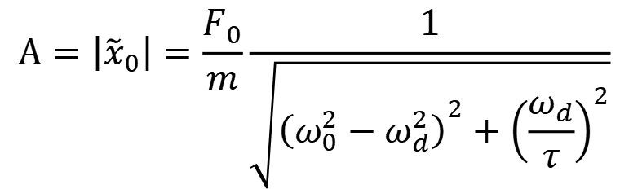
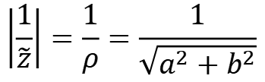
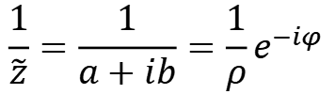

About inverse of complex numbers.
$$\tilde{z}=a+ib=ρe^{iφ}$$
$$\frac{1}{\tilde{z}}=\frac{1}{a+ib}=\frac{1}{ρ}e^{−iφ}$$
$$\left|\frac{1}{\tilde{z}}\right|=\frac{1}{ρ}=\frac{1}{\sqrt{a^{2}+b^{2}}}$$
$$A=\left|{\tilde{x}}_{0}\right|=\left|\frac{F_{0}}{m}\frac{1}{\left(\frac{1}{τ}iω_{d}+ω_{0}^{2}−ω_{d}^{2}\right)}\right|$$
$$A=\left|{\tilde{x}}_{0}\right|=\frac{F_{0}}{m}\frac{1}{\sqrt{{\left(ω_{0}^{2}−ω_{d}^{2}\right)}^{2}+{\left(\frac{ω_{d}}{τ}\right)}^{2}}}$$

Slide 17
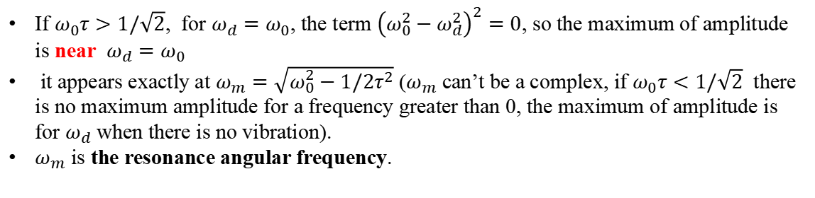
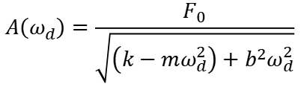
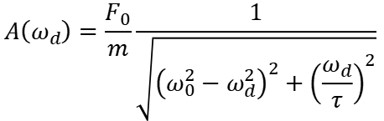
Amplitude of driven oscillations
The amplitude of the driven oscillation $A=\left|{\tilde{x}}_{0}\right|$is:
$$A\left(ω_{d}\right)=\frac{F_{0}}{m}\frac{1}{\sqrt{{\left(ω_{0}^{2}−ω_{d}^{2}\right)}^{2}+{\left(\frac{ω_{d}}{τ}\right)}^{2}}}$$
$$A\left(ω_{d}\right)=\frac{F_{0}}{\sqrt{\left(k−mω_{d}^{2}\right)+b^{2}ω_{d}^{2}}}$$
Or
If $ω_{0}τ>1/\sqrt{2}$, for $ω_{d}=ω_{0}$, the term ${\left(ω_{0}^{2}−ω_{d}^{2}\right)}^{2}=0$, so the maximum of amplitude is near $ω_{d}=ω_{0}$
it appears exactly at $ω_{m}=\sqrt{ω_{0}^{2}−1/2τ^{2}}$ ($ω_{m}$ can’t be a complex, if $ω_{0}τ<1/\sqrt{2}$ there is no maximum amplitude for a frequency greater than 0, the maximum of amplitude is for $ω_{d}$ when there is no vibration).
$ω_{m}$ is the resonance angular frequency.
If $ω_{0}≫\frac{1}{τ√2}$, then $ω_{m}≈ω_{0}$, the resonance angular frequency is approximatively the natural angular frequency !

Slide 18
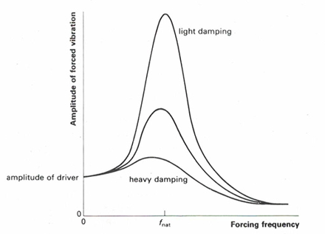
Resonance
http://practicalphysics.org/Hacksaw-blade-resonator.html
Natural frequency $f_{nat}=ω_{0}/2π$
Forcing frequency $=ω_{d}/2π$

Slide 19
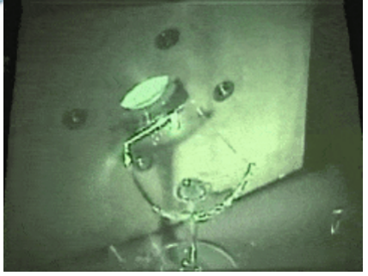

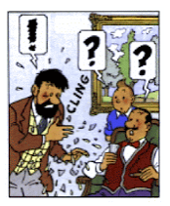
Effect of resonance on a wine glass
Driven oscillations and resonance by using sound.
https://www.youtube.com/watch?v=17tqXgvCN0E
It is also possible by human voice ? Please to read:
https://www.scientificamerican.com/article/fact-or-fiction-opera-singer-can-shatter-glass/
“Tintin” comic book by Herge

Slide 20
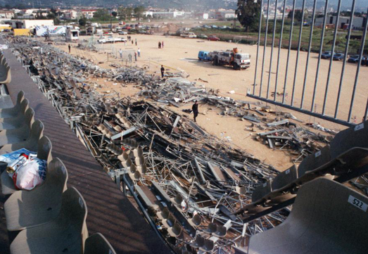
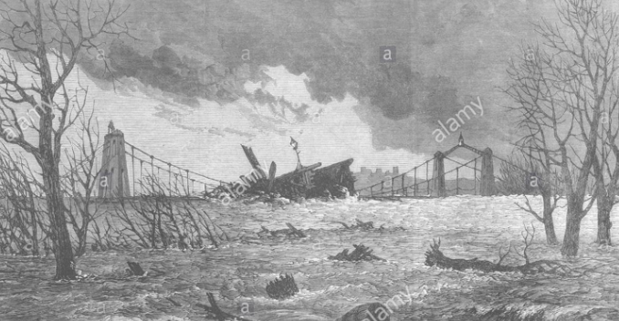
Some bad effects of resonance
Furiani football stadium (1992)
The driven oscillations come from feet of people. Normally, stadium is built in a way to avoid collapsing, but it was built here to quickly, without take care enough about safety.
https://www.francetvinfo.fr/sports/foot/vingt-ans-apres-furiani-la-douleur-des-victimes-en-est-restee-au-meme-stade_90567.html
Broughton Bridge destruction after passage of army men. After that, the army men walk out of step (i.e. don’t walk with synchronized steps) on a bridge (although “vibration caused by the marching had precipitated the bolt's failure, it would have happened anyway”, says A. Smith in "Broughton Bridge is falling down!” article).
An interesting article: http://xautoman.com/13091-whydosoldiersmarchoutofsteponabridge.html

Slide 21
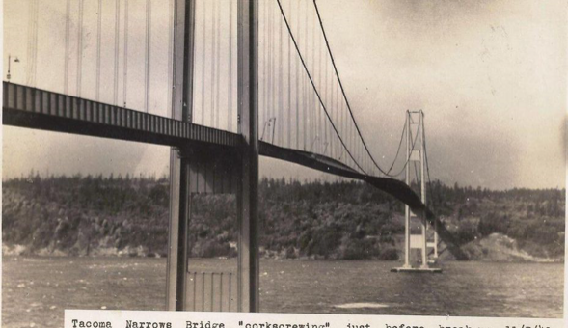
Bridges can be destroyed for other reasons …
Tacoma bridge bouncing and twisting :
https://www.youtube.com/watch?time_continue=36&v=baDEOM-wvUo
https://www.forbes.com/sites/startswithabang/2017/05/24/science-busts-the-biggest-myth-ever-about-why-bridges-collapse/#4bb6b9dd1f4c
“the bridge itself wasn't undulating at its resonant frequency at all! […]”. The reason was aerodynamic phenomenon named “flutter”.

Slide 22

Phase of driven oscillations
The phase difference between the driven oscillation and the periodic excitation is
$$∆φ\left(ω_{d}\right)=\arctan\left(\frac{−ω_{d}/τ}{ω_{0}^{2}−ω_{d}^{2}}\right)$$
The oscillation is late relatively to the excitation,
The phase difference between the oscillations and the excitation is because the effect can’t happens before the causes.

Slide 23

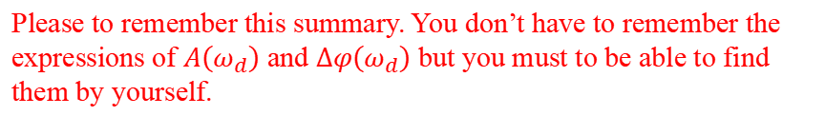


Driven oscillations: summary
$$m\frac{d^{2}x}{{dt}^{2}}+b\frac{dx}{dt}+kx=F_{x}(t)$$
$$\frac{d^{2}x}{{dt}^{2}}+\frac{1}{τ}\frac{dx}{dt}+ω_{0}^{2}x=\frac{F_{x}(t) }{m}$$
The displacement $x(t)$ for the driven oscillations is:
$$x\left(t\right)=Re\{\tilde{x}\}=A cos \left(ω_{d}t+∆φ\right)$$
where
$ω_{d}$ is the angular frequency of the driving force:
$$F_{x}\left(t\right)=F_{0}\cos{(ω_{d}t)}$$
$A\left(ω_{d}\right)=\left|{\tilde{x}}_{0}\right|$ is the amplitude of the driven oscillations
Resonance: there is a maximum value of $A\left(ω_{d}\right)$ at $ω_{m}=\sqrt{ω_{0}^{2}−1/2τ^{2}}$
$∆φ\left(ω_{d}\right)$ is the phase difference between the driven oscillations and the driven force.
Please to remember this summary. You don’t have to remember the expressions of $A\left(ω_{d}\right)$ and $∆φ\left(ω_{d}\right)$ but you must to be able to find them by yourself.

Slide 24
Middle-term examination
Contents: Everything seen until today included (thus, included the SHM, and the damped and driven oscillations).
Rules (same than the quick test you have done):
Calculator without memory allowed
Chinese-English dictionary allowed
Calculator with memory and phone forbidden.
I don’t know the date of the mid-term exam. Certainly not next week, but be prepared in case of.

Slide 25
Before to continue lectures, a small quiz
For practice, please to take a piece of paper. For each question, I give you two minutes to reply.
I reminds you that you must to know the equations needed to solve problems for the mid-term exam.

Slide 26

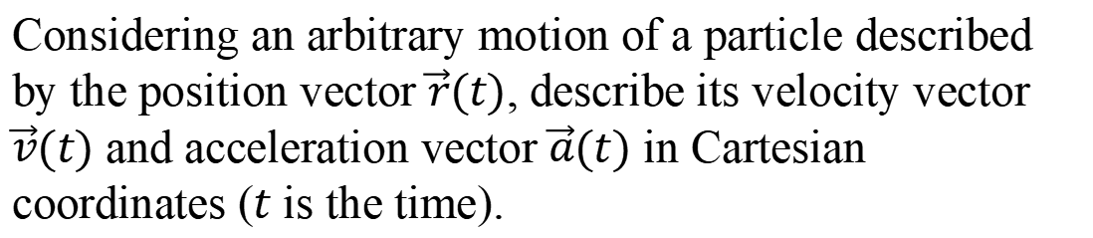
Question 1
Considering an arbitrary motion of a particle described by the position vector $\vec{r}(t)$, describe its velocity vector $\vec{v}(t)$ and acceleration vector $\vec{a}(t)$ in Cartesian coordinates ($t$ is the time).

Slide 27
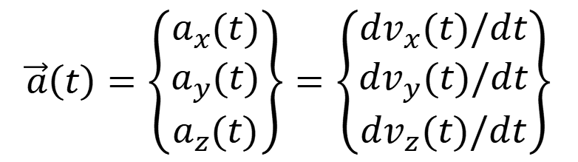
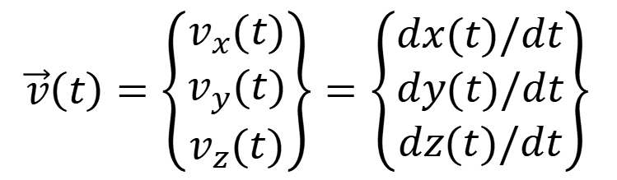
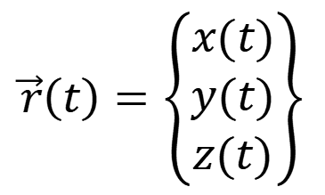
Question 1
$$\vec{r}\left(t\right)=\left\{\begin{matrix}x(t) \\ y(t) \\ z(t)\end{matrix}\right\}$$
$$\vec{v}\left(t\right)=\left\{\begin{matrix}v_{x}(t) \\ v_{y}(t) \\ v_{z}(t)\end{matrix}\right\}=\left\{\begin{matrix}dx(t)/dt \\ dy(t)/dt \\ dz(t)/dt\end{matrix}\right\}$$
$$\vec{a}\left(t\right)=\left\{\begin{matrix}a_{x}(t) \\ a_{y}(t) \\ a_{z}(t)\end{matrix}\right\}=\left\{\begin{matrix}dv_{x}(t)/dt \\ dv_{y}(t)/dt \\ dv_{z}(t)/dt\end{matrix}\right\}$$

Slide 28
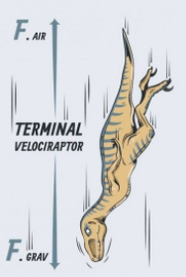
Question 2
Describe the Newton’s 2nd law for a rigid body to describe its translational motion and the rotational analogy of the Newton’s second law to describe its rotational motion.

Slide 29


Question 2
Newton’s second law:
$$m\vec{a}=\vec{F}$$
Mass of the body
Net force exerted on the body
Acceleration vector of the center of mass of the body
Rotational analogy:
I$\vec{α}=\vec{τ}$
Moment of inertia about the axis of rotation of the body
Net torque exerted on the body about the pivot
Angular acceleration vector

Slide 30
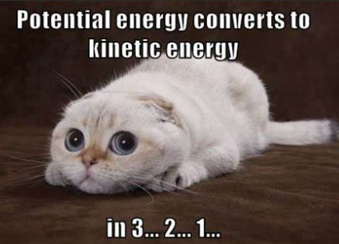
Question 3
Describe the gravitational potential energy associated with the weight of a body, the elastic potential energy in a spring-mass system associated with the spring force, and the (translational) kinetic energy of a body. What could change the mechanical energy of a body ?

Slide 31
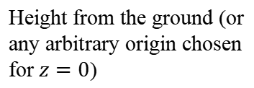

Question 3
Gravitational potential energy associated with the weight:
$$E_{p,grav}=mgz$$
Mass of the body
Height from the ground (or any arbitrary origin chosen for $z=0$)
Gravitational acceleration constant: $g=9.81 m,s^{−2}$

Slide 32
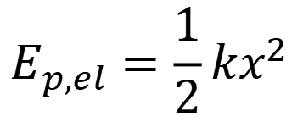
Question 3
Elastic potential energy associated with the spring force:
$$E_{p,el}=\frac{1}{2}kx^{2}$$
Distance from equilibrium
Spring coefficient,
Or spring force constant

Slide 33


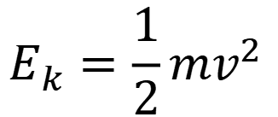
Question 3
Translational Kinetic energy of a body of mass $m$ and velocity $v$:
$$E_{k}=\frac{1}{2}mv^{2}$$
Velocity (magnitude of the velocity vector)
Mass of the body
What could change the mechanical energy of a body ?
$$ΔE_{m}=W_{other}$$
Work done by non-conservative forces such as the friction forces
I reminds you:
$$E_{m}=E_{k}+E_{p}$$

Slide 34

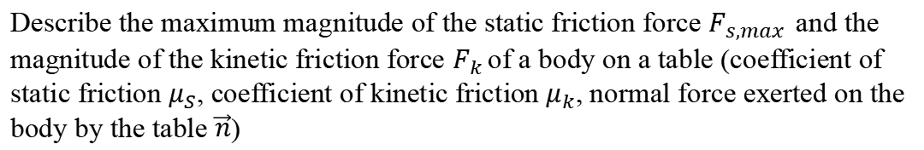
Question 4
Describe the maximum magnitude of the static friction force $F_{s,max }$and the magnitude of the kinetic friction force $F_{k }$of a body on a table (coefficient of static friction $μ_{S}$, coefficient of kinetic friction $μ_{k}$, normal force exerted on the body by the table $\vec{n}$)

Slide 35


Question 4
For the static friction force magnitude:
$$F_{s}≤μ_{S}n$$
Magnitude of the normal force
Coefficient of static friction
Maximum magnitude of the static friction force:
$$F_{s,max}=μ_{S}n$$

Slide 36

Question 4
For the kinetic friction force magnitude:
$$F_{k}=μ_{k}n$$
Magnitude of the normal force
Coefficient of kinetic friction

Slide 37


Question 5
Describe the principle of conservation of (linear) momentum $\vec{p}$ and the principle of conservation of angular momentum $\vec{L}$. For what kind of problem these principles are very useful ?

Slide 38
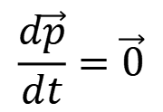

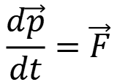
Question 5
Describe the principle of conservation of (linear) momentum $\vec{p}$
$$\frac{d\vec{p}}{dt}=\vec{F}$$
$$\frac{d\vec{p}}{dt}=\vec{0}$$
If $\vec{F}=\vec{0}$ then
Momentum is conserved
Net force exerted on a system (external forces)

Slide 39
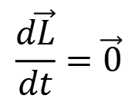

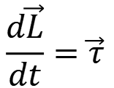
Question 5
Describe the principle of conservation of angular momentum $\vec{L}$ of a body in rotation:
$$\frac{d\vec{L}}{dt}=\vec{τ}$$
$$\frac{d\vec{L}}{dt}=\vec{0}$$
If $\vec{τ}=\vec{0}$ then
Momentum is conserved
Net torque exerted on a system (external forces) about a point
!
Net torque and angular momentum are always defined about a point (usually we consider a point of the axis of rotation).
Principle of conservation of momentum is useful to describe collisions when there is not external force exerted on a system of two bodies.

Slide 40

Question 6
Picture just for the joke, the motion of a point of a chord is not SHM, the motion is damped by friction.
Describe a simple harmonic motion $x(t)$

Slide 41

Question 6
Describe a simple harmonic motion $x(t)$
$$x\left(t\right)=A\cos\left(ωt+φ\right)$$
Phase angle
Amplitude of the SHM
Angular frequency (or angular velocity, both are right)

Slide 42


Question 7
Take care, this joke is right only in a particular case …
Describe the infinitesimal work $dW$ done by a force $\vec{F}$exerted on a body or a particle. What is the work done by the net force (i.e. the net work) in terms of energy ?

Slide 43



Question 7
Describe the infinitesimal work $dW$ done by a force $\vec{F}$exerted on a body or a particle. What is the work done by the net force ?
$$dW=\vec{F}.d\vec{s}$$
Infinitesimal displacement vector
For any displacement, the work done by $\vec{F}$ is:
$$W=\int{dW}=\int{\vec{F}.d\vec{s}}$$

Slide 44

Question 7
The net work (or work done by the net force) is the change of kinetic energy:
$$ΔE_{k}=W_{net}$$
Net work
Change of kinetic energy of a body

Slide 45


Question 8
A particle has a circular motion of radius R, describe its tangential and normal acceleration, and its angular velocity $ω$ in terms of its velocity $v.$ Same question if the circular motion is uniform circular motion.

Slide 46








Question 8
$${\vec{a}}_{t}$$
$$\vec{a}$$
particle
$$R$$
$${\vec{a}}_{n}$$
$\vec{v}$: velocity vector
$${\vec{a}}_{t}=a_{t}\hat{t}=\frac{dv}{dt}\hat{t}$$
Tangential acceleration:
$${\vec{a}}_{n}=a_{n}\hat{n}=\frac{v^{2}}{R}\hat{n}$$
Normal acceleration (i.e radial acceleration):
Angular velocity :
$$ω(t)=\frac{v(t)}{R}$$
$\hat{n}$: unit vector normal to the trajectory
$\hat{t}$: unit vector tangent to the trajectory

Slide 47



Question 8
$$\vec{a}$$
particle
$$R$$
If the circular motion is uniform, $v=constant$
$${\vec{a}}_{t}=a_{t}\hat{t}=\frac{dv}{dt}\hat{t}=\vec{0}$$
Tangential acceleration:
$${\vec{a}}_{n}=a_{n}\hat{n}=\frac{v^{2}}{R}\hat{n}=\vec{a}$$
Normal acceleration (i.e radial acceleration):
Angular velocity :
$$ω\left(t\right)=\frac{v}{R}=constant$$
$\hat{n}$: unit vector normal to the trajectory
$\hat{t}$: unit vector tangent to the trajectory

Slide 48
Of course
The quiz questions here are not the only things to remember, for instance, you must to know what is a torque by a force, what is an angular displacement, angular velocity and angular acceleration, the main units used and so on …
The best way to know what is important to remember is to check the homework (you can check also on a ppt in the summary and/or when I say something is “important to remember”)

Slide 49
End of lecture 14

